Slide 1
ECE Robotics and Microcontroller Workshop

Slide 2






Introductions
Prof. Hamid Timorabadi
h.timorabadi@utoronto.ca
Ryan Seto
ryan.seto@mail.utoronto.ca
Iris Wang
irisjiayi.wang@mail.utoronto.ca
Nick Mutlak
n.mutlak@mail.utoronto.ca
Shuntaro Wakamatsu
shuntaro.wakamatsu@mail.utoronto.ca
Simon Xu
xiaofengsimon.xu@mail.utoronto.ca

Slide 3




Preamble
Mechanical
Electrical
Software

Slide 4




Preamble
Fusion 360 and 3D Printing
Adafruit Feather (ATmega32u4)
Arduino

Slide 5
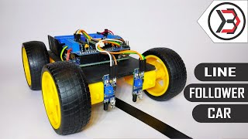
Workshop Objective

Slide 6
Workshop Roadmap
Day 1
Day 2
Day 3
Learning how to CAD and why engineers use it
Learning microcontrollers and general signal I/O
Controlling motors and basic line tracking
Day 4
Day 5
Day 6-8
Discussing 3D printing and designing your own robot
Programming bluetooth control and maze challenge
Programming your design for the final competition

Slide 7
Challenges and Prizes
Challenge 1: Basic Line Tracking (Day 3)
Your robot will have to autonomously traverse a simple line tracking course consisting of straight lines and shallow curves
Fastest team to complete the course with the most precise line tracking wins a prize (TBD)
Challenge 2: Piloted Maze (Day 6)
You will have to drive your robot through a maze of pins as the walls quickly
Knocking over any pins results in a time penalty
Fastest team wins a prize (TBD)

Slide 8

Challenges and Prizes Cont’d
Challenge 3: Advanced Line Tracking (Day 8)
Your robot will have to autonomously traverse a complicated line tracking course with sharp turns, dotted lines, and dead ends
Fastest team to complete the course with the most precise line tracking gets to keep their robot ($150+ kit)

Slide 9

Activity and Challenge Sheets
Phase 1: Guided Learning (Day 1-3)
Activity 1-2: Learning how to CAD
Activity 3-4: Programming a microcontroller for signal input and output
Activity 5: Getting the robot in motion
Challenge 1: Basic line tracking challenge
Phase 2: Open Designing (Day 4-8)
Activity 6: Designing your own robot CAD
Activity 7: Bluetooth manual control of robot
Challenge 2: Piloted maze challenge
Challenge 3: Advanced line tracking challenge

Slide 10
Final Notes Before We Begin
This workshop will be cover a lot of content at a high level to expose you to many facets of engineering, so if you ever feel lost ask questions earlier rather than later, as the subsequent lessons will feel overwhelming. Throughout the workshop, we will be covering bits and pieces from multiple courses in your second year:
Visualizing 3D shapes in CAD → Helps with MAT291 (Calculus 3) and 3D integration
Working with digital signals → Helps with understanding the context behind ECE241 (Digital Systems) → Helps with understanding discrete signals in ECE216 (Signals and Systems)
Programming a processor to execute some code and different types of communication protocols → Helps with ECE243 (Computer Organization) labs

Slide 11
01
CAD Modelling and Fusion 360

Slide 12
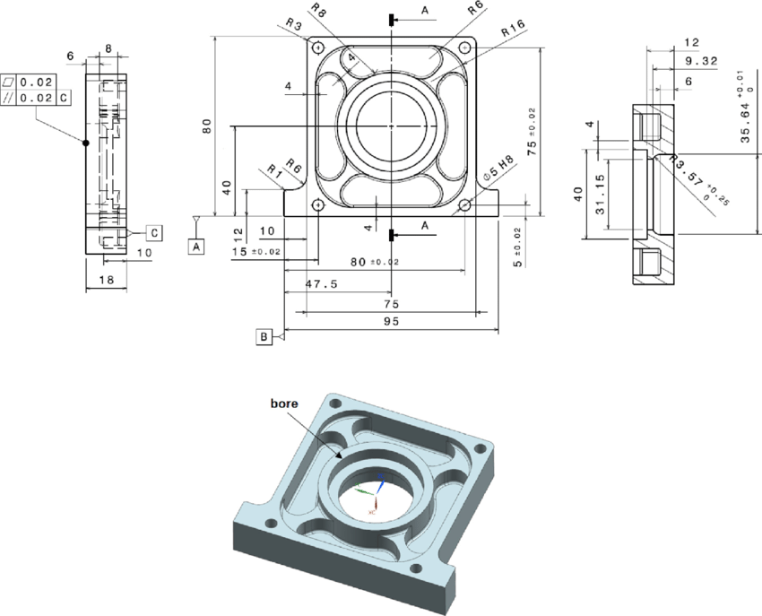
What is CAD Modelling?
CAD Modelling is a tool for engineers to design the shapes of their part(s) in order to manufacture it in a shop or fabrication center.
Allows engineers to simulate a design before actually building their design
Before CAD modelling, engineers would have to make 2D drawings of a part
2D Drawing
3D CAD Model

Slide 13
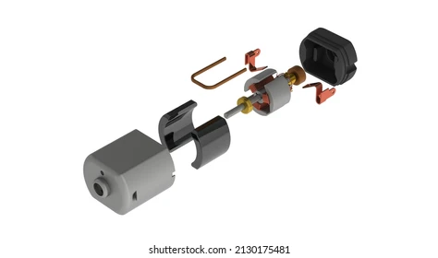
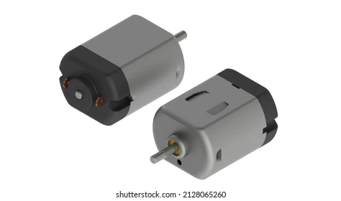
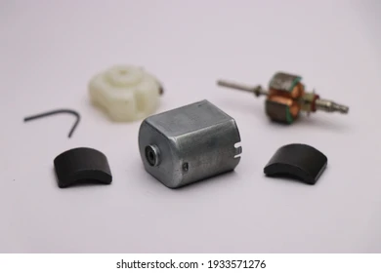
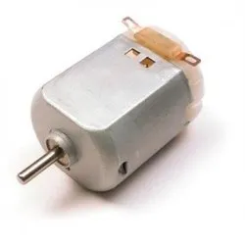
Design and Manufacturing Cycle
CAD Design
CAD Each Part/Component
Build a CAD Assembly
Manufacture Design
Manufacture Each Part
Physically Assemble

Slide 14
Benefits of CAD
CADing/simulating a design has three main benefits:
Allows engineers see if all the parts they design will fit together during assembly (proper clearance and no collisions/conflicts)
Allow engineers to assign densities to parts and see the total mass and the center of mass of the design alongside other physical properties (validating weight requirements)
Allows modifications to old models without compromising the original model (version history to refer back to old designs)
No longer need to redraw the model from scratch in order to modify it

Slide 15
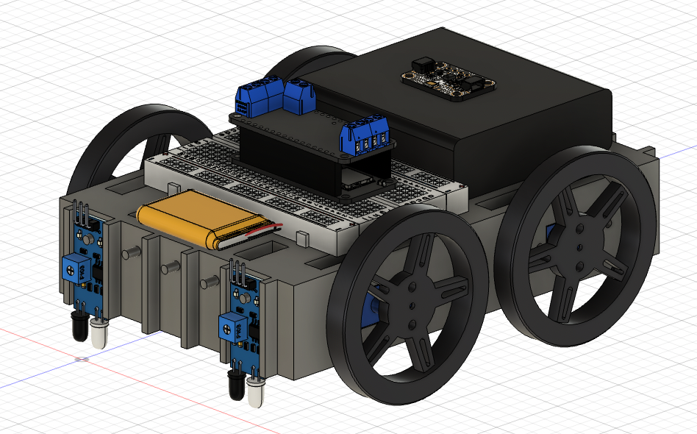
What Are You Designing?

Slide 16
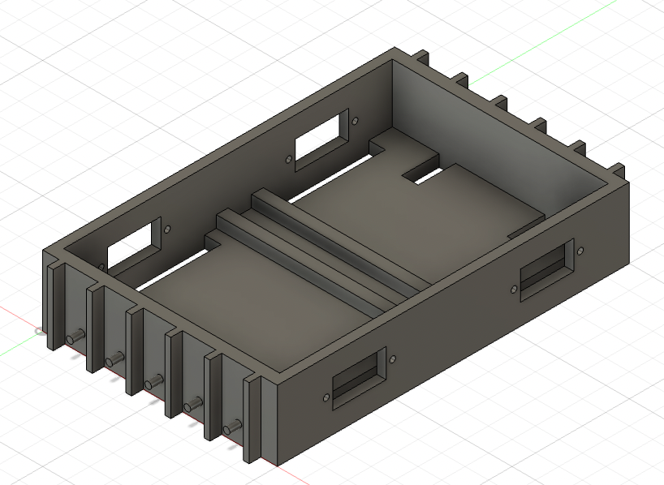
Activity 1: Learning How to CAD Components
To learn how to build individual parts/components, you’ll be following a tutorial to CAD this drivebase. Handout is on your workbench or in the directory.

Slide 17
BREAK
Be back in 15 minutes

Slide 18
Activity 2: Learning How to CAD Assemblies
Next, to learn how to make CAD assemblies you’ll be following a second tutorial to complete the full drivetrain assembly. If you’re missing all the files, please talk to an instructor or revisit the preparation handout for this workshop.

Slide 19
Design Process Behind Drivebase
Summary:
Drivebase size is limited by the printing bed size
Top of drivebase is flat to facilitate better bed adhesion for 3D printing
Motor cutouts were made larger than necessary to ensure the motor can fit
Ribs were attached for more structural support
Multiple IR sensor mounts were created to allow you to experiment with where to place your IR sensors
The mount peg was made slightly smaller than the IR sensor hole to ensure the sensor could fit on top
Wire cutouts double as a place to fasten the batteries with a belt

Slide 20
Day 1 Complete!

Slide 21
02
Microcontrollers
Processors, Pinouts, and Digital Signals

Slide 22
What is a Microcontroller
A microcontroller is a small, integrated circuit that you can program to complete specific tasks
Ex: turn on an LED, spin a motor, monitor the ambient light in a room
Program a microcontroller to generate the signal and control a circuit
Manually adjust function/signal generator to control a circuit

Slide 23
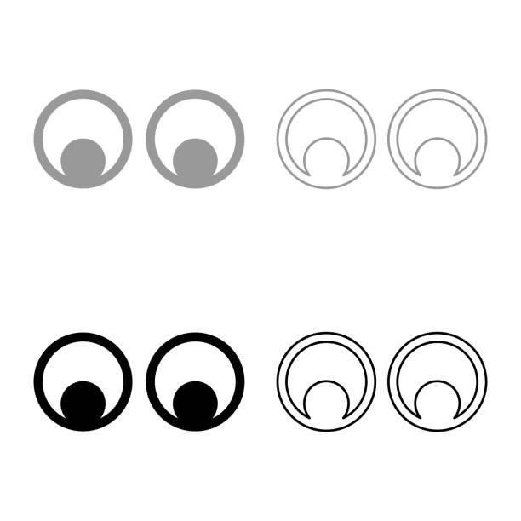




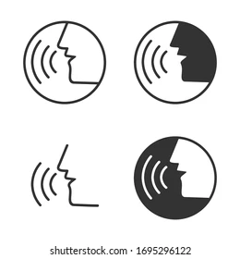

Microcontroller Analogy
Input
Blood
Brain Signal
Output

Slide 24


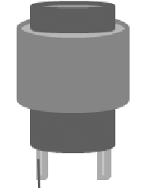
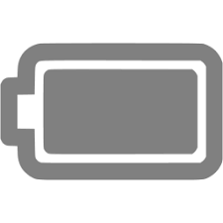


Microcontroller Analogy
Input Peripheral
Power
Electrical Signal
Pin/Node
Output Peripheral

Slide 25
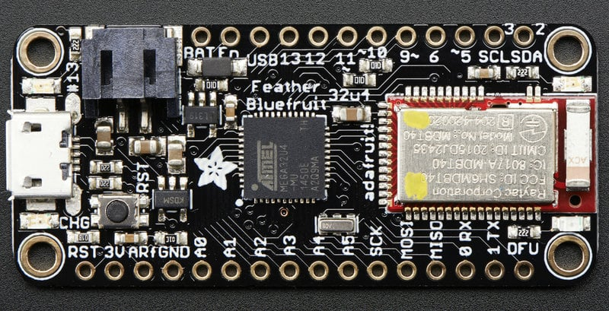
The Microcontroller You Will Be Using

Slide 26
Processor and Internal Peripherals
USB Peripheral
Bluetooth Peripheral
Processor Chip (ATmega32u4)

Slide 27
Power Pins
BAT pin and JST Connector for LiPo battery power
GND pin: voltage ground for all logic and power
3V pin: 3V voltage source to power external peripherals

Slide 28
Microcontroller Analogy
Input Peripheral
Recall…
Power
Electrical Signal
Pin/Node
Output Peripheral

Slide 29
Power Pins
BAT pin and JST Connector for LiPo battery power
GND pin: voltage ground for all logic and power
3V pin: 3V fixed voltage source to power external peripherals

Slide 30
Programming Pins
USB pin and MicroUSB Connector for connecting the board to your computer
MicroUSB Power

Slide 31
Variable Signal Pins
Digital Pins (1/0)
Notice digital pins 4, 7 and 8 are missing. They are used by the Bluetooth Peripheral so they cannot be used.
PWM Pins:
(3, 5, 6, 9, 10, 11, 13)
Analog Pins

Slide 32
Microcontroller Analogy
Input Peripheral
Power
Electrical Signal
Pin/Node
Recall…
Output Peripheral

Slide 33
Digital vs. Analog Signals
Recall that the microcontroller receives and sends electrical signals through the input peripherals and output peripheral. These electrical signals are voltages
An analog signal is a continuous/real signal like the signals you’ve worked with up to this point in electrical courses
A digital signal is an analog signal broken down into discrete value (ie. a processed analog signal) and transmitted as a pulse/serially (ie. strings of bits)

Slide 34

Digital Signal Analogy
HELLO WORLD
Speech
Words
Alphabet
Discretized
Form String
If you know how to interpret words, you can always remake the spoken word

Slide 35
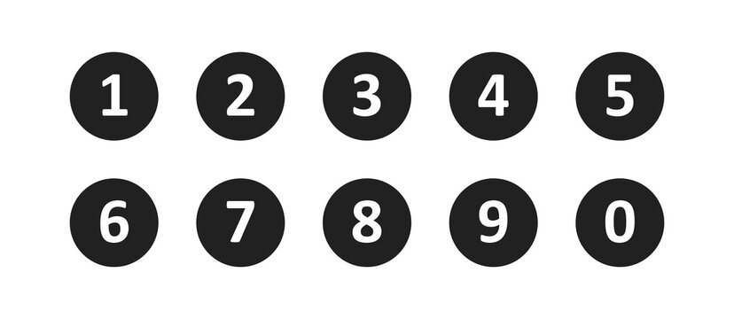
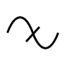
Digital Signal Analogy
5 4 6 1 8 2 …
Analog Signal
List of Numbers
Numbers/Values
Discretized
Form String
If you know how to interpret the list, you can always rebuild the original signal

Slide 36
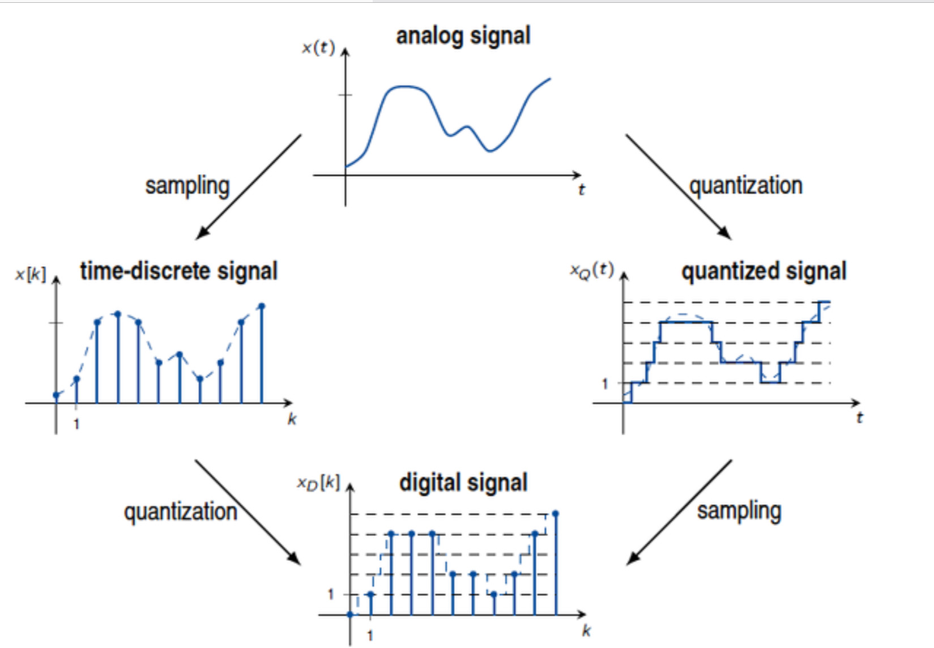
Graphical Interpretation
Discretization
4
4
We’re sampling the function
Form String
Successfully broken down an analog signal
x[k] = [1, 4, 4.2, 4, 2, 2.3, 1, 2, 4, 4.6]

Slide 37
Digital vs. Analog Signals
Recall that the microcontroller receives and sends electrical signals through the input peripherals and output peripheral. These electrical signals are voltages
An analog signal is a continuous/real signal like the signals you’ve worked with up to this point in electrical courses
A digital signal is an analog signal broken down into discrete value (ie. a processed analog signal) and transmitted as a pulse/serially (ie. strings of bits)
1
2

Slide 38
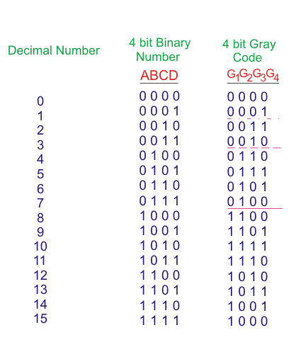
Binary Numbers and Bits
A bit (binary digit) is a digit that only has two values: 1 (on) or 0 (off). A binary number is a string of bits. We can represent standard decimal integers with combinations/strings of bits like the following:

Slide 39
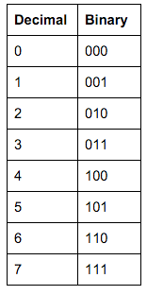
Binary Numbers and Bits Cont’d
With 4 bits (2 values), we can get 16 unique integers…, how many integers can you represent with 3 bits?
Recall for decimal numbers, 3 digits ⇔ 0 to 999 ⇔ 1000 values
⇔ 10³
8
⇔ 2³
⇔ (base)^{(# digits)}

Slide 40
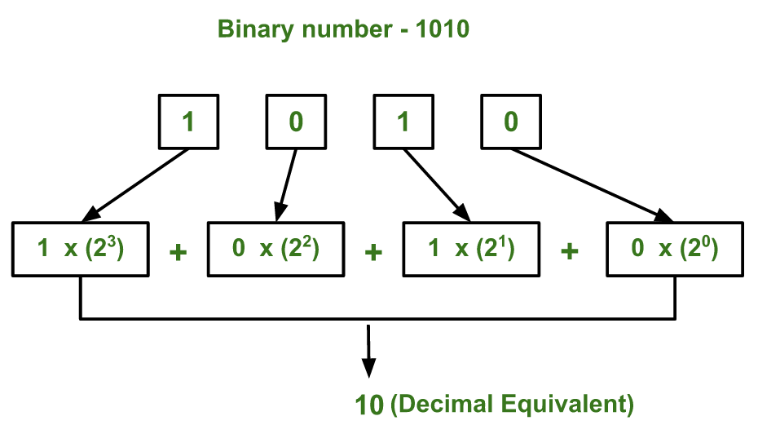
Binary-to-Decimal Conversion
Most Significant Bit
Largest influence on magnitude
Least Significant Bit
Smallest influence on magnitude

Slide 41
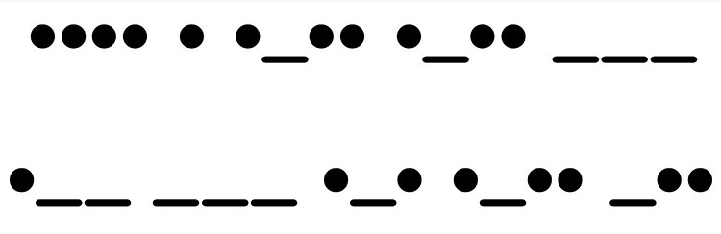
Digital Signal Analogy Cont’d
HELLO WORLD
Words
Morse Code

Slide 42
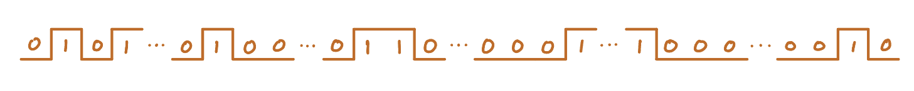
Digital Signal Analogy Cont’d
5 4 6 1 8 2 …
0101 0100 0110 0001
1000 0010 …
List of Numbers
String of Bits
Serial Communication

Slide 43
Graphical Interpretation
Discretization
4
4
Form String
x[k] = [1, 4, 4.2, 4, 2, 2.3, 1, 2, 4, 4.6]
x[k] = [1, 4, 4.2, 4, 2, 2.3, 1, 2, 4, 4.6]

Slide 44
Graphical Interpretation
Round
4
Form String
Rounding to quantized levels
x[k] = [1, 4, 4, 4, 2, 2, 1, 2, 4, 5]

Slide 45

Summary of Digital Signals
Digital signals are analog signals that have been sampled and quantized into discrete, integer values that can be encoded into a pulse wave for serial communication

Slide 46
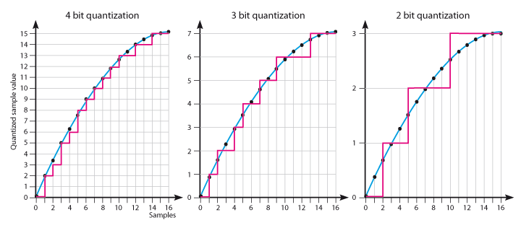
Analog Signal Chopping (Discretization)
Larger bit length (n) means more precise digitization

Slide 47
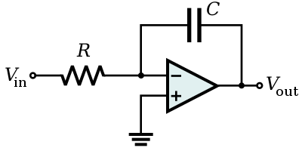
Why Not Use An Analog Computer?
This seems like a lot of work to create convert analog signals into digital signals, so why do this? The reason is because analog computers are not easy to modify, meaning an analog computer needs to be built for a specific purpose whereas digital computers are very easy to modify and you can rebuild analog signals from digital ones. You’ll learn more about the math behind the signal processing in ECE216.
Op Amp Integrator
(Cannot be used for anything else)

Slide 48
Signal Pins
Digital Pins (1/0)
Notice digital pins 4, 7 and 8 are missing. They are used by the Bluetooth Peripheral so they cannot be used.
PWM Pins:
(3, 5, 6, 9, 10, 11, 13)
Analog Pins

Slide 49
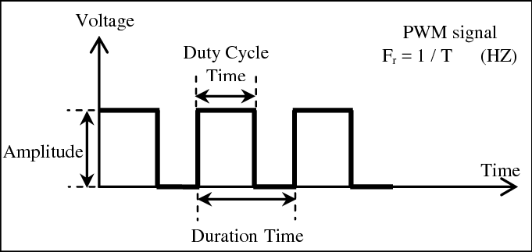
Pulse Width Modulation (PWM)
A pulse is a signal that switches between HIGH and LOW
Pulses with a frequency can undergo PWM

Slide 50
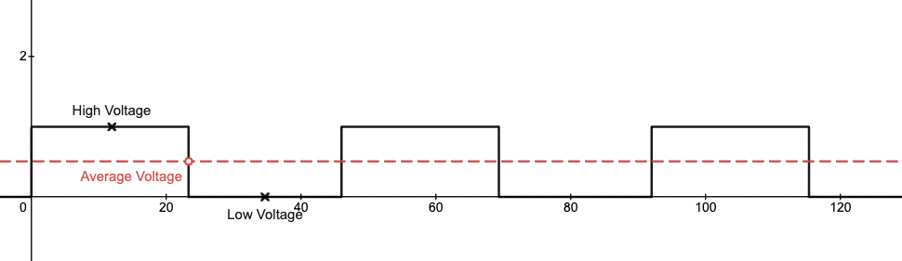
Average Value of a PWM
Like other AC signals, a repeating pulse has an average value; this average value can be thought of as the DC value of a PWM signal.
Link to Desmos Demo

Slide 51
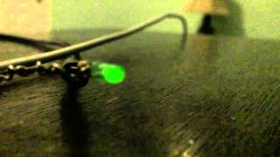
PWM and LED Brightness

Slide 52
Signal Pins
Digital Pins (1/0)
Notice digital pins 4, 7 and 8 are missing. They are used by the Bluetooth Peripheral so they cannot be used.
PWM Pins:
(3, 5, 6, 9, 10, 11, 13)
Analog Pins

Slide 53
Signal Pins Cont’d
I2C Serial Data
I2C Serial Clock
Optional content in activity appendices
SPI Serial Clock (SCK), Master-Out-Slave-In (MOSI) and Master-In-Slave-Out (MISO)
UART Receive (Rx) and Transmit (Tx)

Slide 54
Other Pins
Reset (RST) Pin and Button
Analog Reference (ARef) Pin
Device Firmware Upgrade (DFU)

Slide 55
Activity 3: Microcontroller Flashing LED
To introduce you to programming a microcontroller, we’ll start by getting an LED to flash. Find the tutorial in the directory in the QR Code

Slide 56
Activity 4: Reading Input From Sensors
Now that you know how to write digital and analog signals, you’ll learn how to read digital and analog signals using an IR sensor and light sensor.

Slide 57
Day 2 Complete!

Slide 58
03
Robot In Motion
H-Bridges, Motorshield Library, Line Tracking

Slide 59
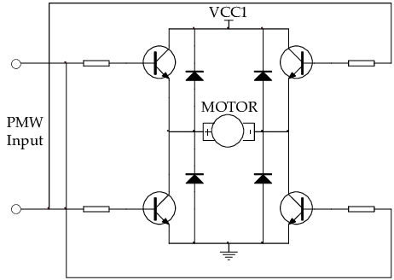
Review/Intro of H-Bridges
The H-Bridge is a circuit that allows you to safely control the speed of a motor using PWM and the direction of a motor through the transistors.
In1
On
Off
Forward
Off
On
Backward
Off
On
In2
On
Off

Slide 60
Review/Intro of H-Bridges
The H-Bridge is a circuit that allows you to safely control the speed of a motor using PWM and the direction of a motor through the transistors.
In1
Off
Off
Off
Off
In2
Release

Slide 61
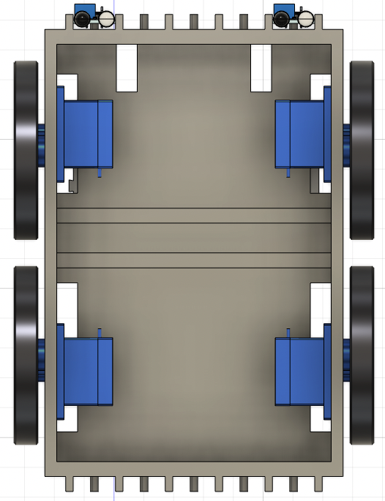
PWM Pins on The Board
To control the speed and direction of 4 DC motors, we need 8 PWM pins. What’s the problem?
→ We only have 7 PWM pins on the board
How can we get more PWM pins?

Slide 62
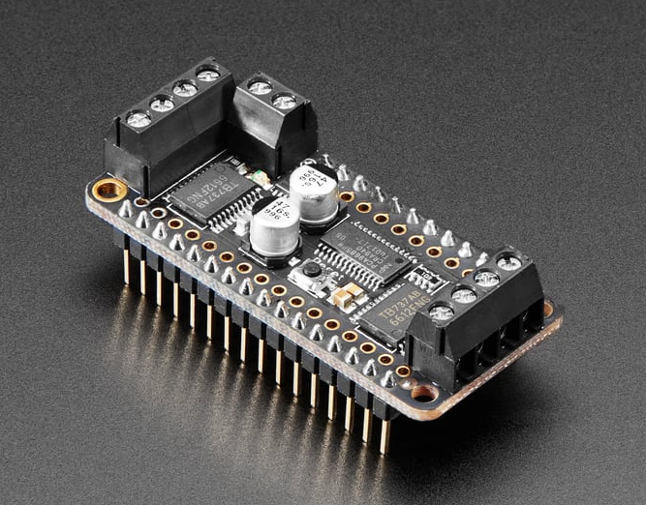
Motorshield

Slide 63
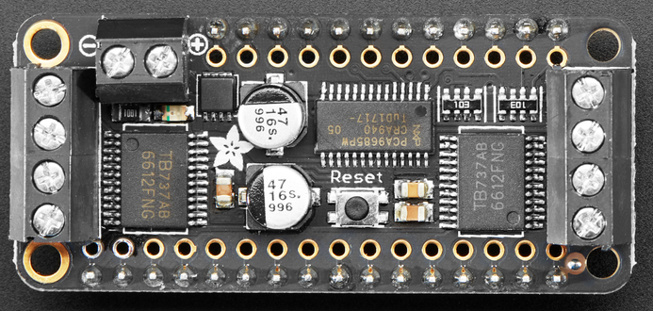
PWM Driver
PWM Driver
Takes 2 PWM pins and maps them to 8 PWM pins

Slide 64
H-Bridges and Power
Battery Port (Note the polarity)
Motor Terminal
Motor Terminal
Two H-Bridges
Two H-Bridges

Slide 65
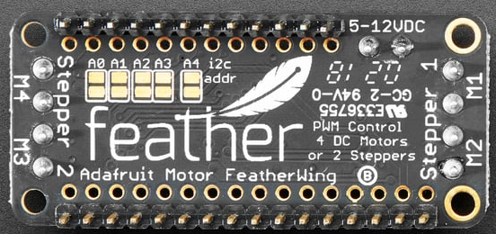
H-Bridges and Power Cont’d
Battery Range
Motor Indexes
Motor Indexes

Slide 66
Activity 5: Motor Control
In this activity you’ll start working with the motorshield to get a motor spinning with a wheel on it. QR Code for the worksheet directory is provided.

Slide 67
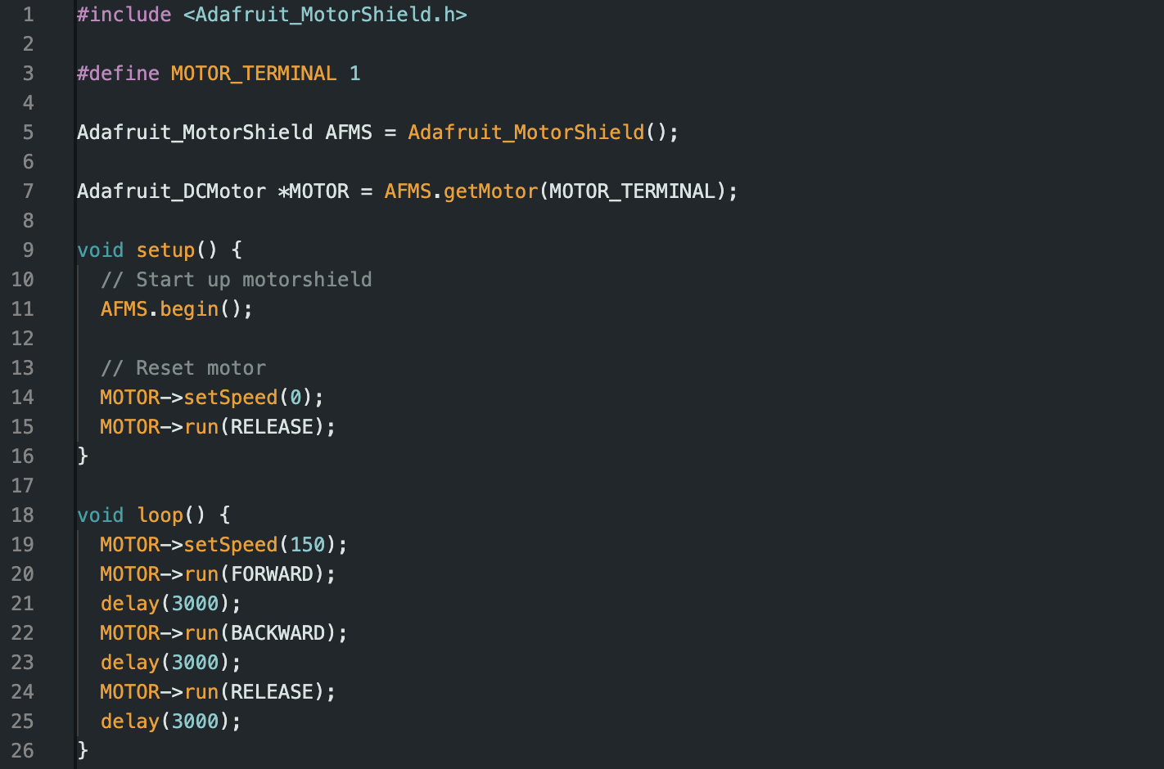
Motor Control Code

Slide 68

Motor Control

Slide 69
BREAK
Be back in 20 minutes

Slide 70
Challenge 1: Basic Line Tracking
Now you have all the tools and components to build your robot and program it to autonomously follow a black line to a destination:
Program the light sensor to activate your robot with your phone flashlight
Program the motors to move the robot
Program the IR sensors to detect black lines and adjust accordingly

Slide 71
How to Line Track
Suggestion 1:
Drive along the line as long as you detect white on the sides of the robot
Turn left/right based on which side detects black
Suggestion 2:
Drive along the line as long as you detect black on the sides of the robot
Turn left/right on which side detects white

Slide 72
Day 3 Complete!

Slide 73
04
Designing Your Own Robot
Microcontroller Protection, Challenge Description, Open Designing

Slide 74
What is 3D Printing
3D printing is a type of additive manufacturing that builds a model layer by layer to form the final shape.
There are two popular types of 3D printing:
Fused Deposition Modelling (FDM) or Fused Filament Fabrication (FFF)
Stereolithography (SLA)

Slide 75

FDM Printing

Slide 76
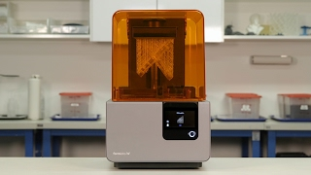
SLA Printing

Slide 77

Slicers
A slicer is a piece of software that breaks down your 3D models into the layers of your print where you can preview the entire printing process. If you’d like, you can download the slicer yourself and preview your prints.

Slide 78
Considerations of FDM Printing
For this workshop, you will be designing a drivebase for FMD printing. This comes with three major considerations that you’ll need to design around:
Bed Size
Bed Adhesion
Support Placement

Slide 79
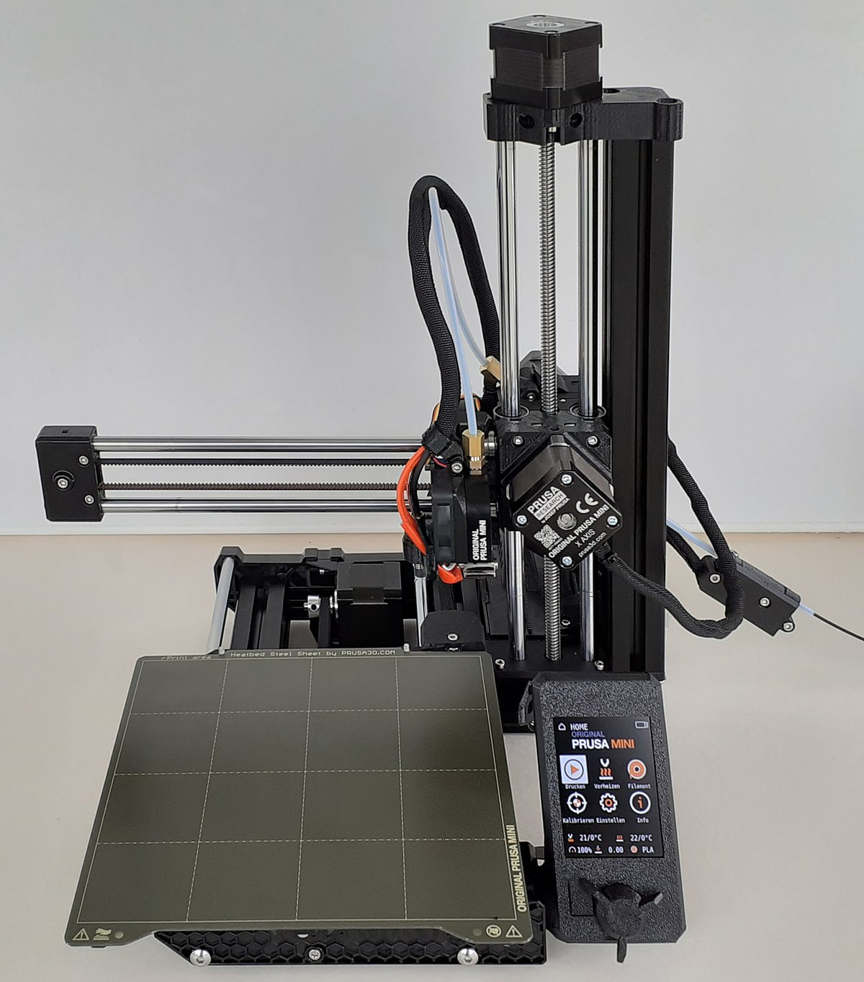
Bed Size
17cm printing height
17x17cm bed

Slide 80
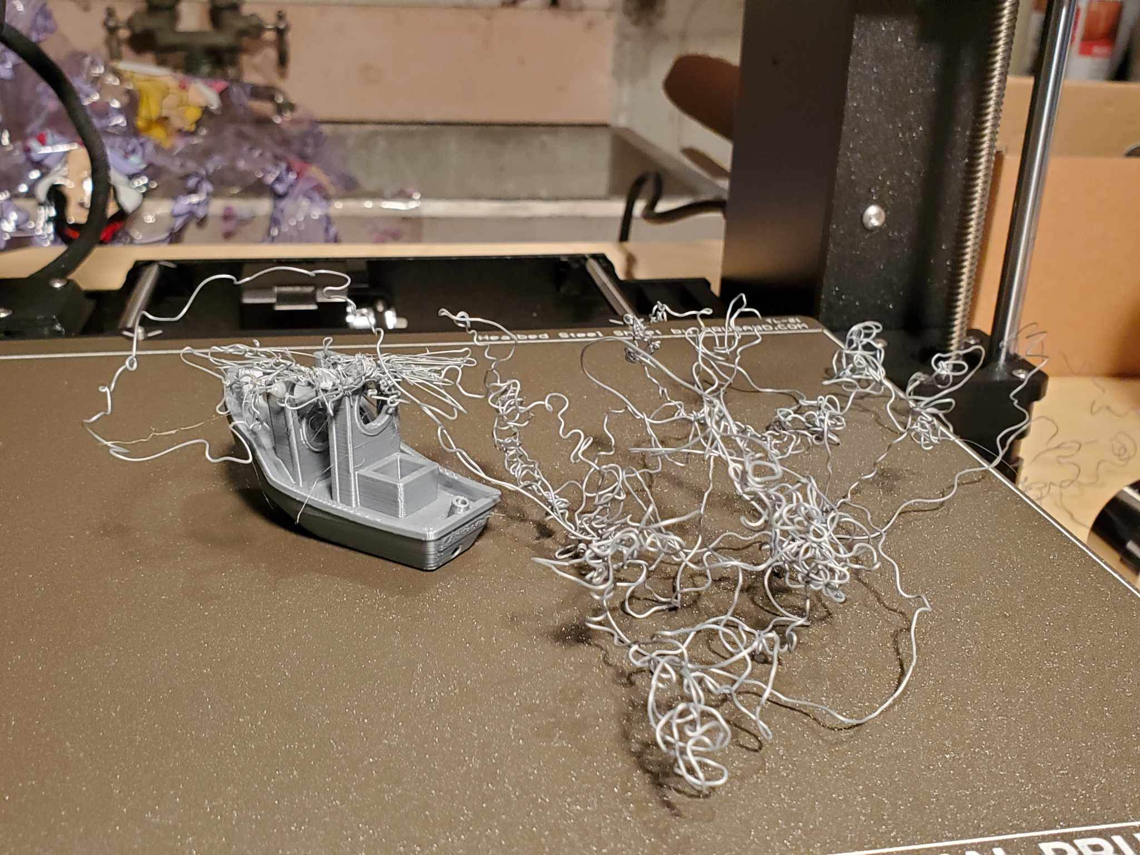
Bed Adhesion
If your part does not stick to the bed of the printer, it may fly off mid-print and become a spaghetti-monster

Slide 81
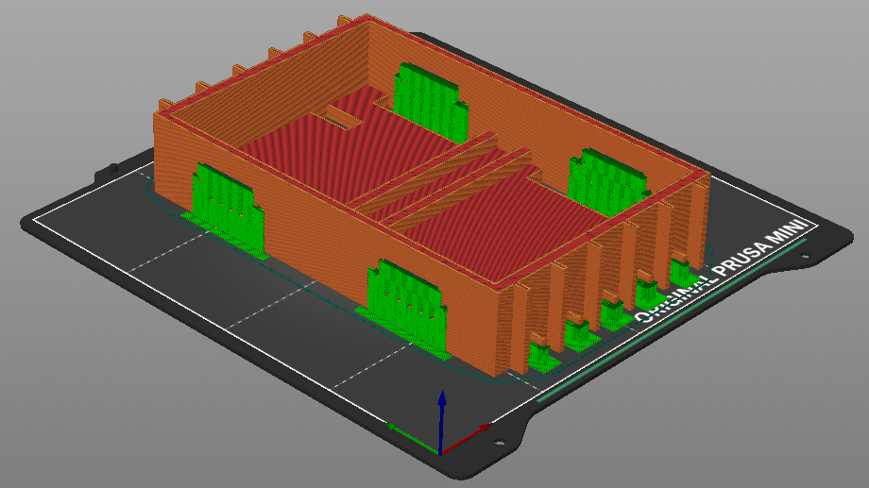
Support Placement
Supports are extra 3D printed extrudes that are necessary for elevated features to be printed properly. Recall that FDM works layer by layer, so an elevated feature needs something below it to be printed onto.

Slide 82
DESIGN TIME

